Slide 1




INTRODUCTION TO GIT AND GITHUB
A guide by Bluechip
-- Gbadeyanka Abass

Slide 2
COURSE CONTENT
Installing Git
Introduction to Version Control
Git Basics
Creating a new Local Git repository
Cloning a Git repository
Making use of Git Commit History
Reverting files to previous states

Slide 3
Installing Git
Windows:
https://git-scm.com/download/win
2. Mac:
https://git-scm.com/download/mac
3. Linux:
sudo apt-get install git (Ubuntu)
or sudo yum install git (Fedora).
4. Once installed check Git version:
git —version

Slide 4
FIRST TIME GIT CONFIGURATION
Your Identity
git config --global user.name “Your Name”
git config —global user.email example@nesu.edu
2. Your Editor
git contig --global core.editor <editor like vim, emacs etc>
3. Enable color in git
git config global color.ui auto
4. Checking your settings
git config --list

Slide 5
INTRODUCTION TO VERSION CONTROL
“Git is an example of Version Control”
Version control is a system that records changes to a file or set
of files over time so that you can recall specific versions later.
It allows you to:
* Revert files to previous state
* Revert entire project back to previous state
* Compare changes over time
* See who modified what? And much more...
It means if you screw things up or lose files, you can easily
recover.

Slide 6
OTHER POPULAR VERSION
CONTROL SYSTEM
Subversion (SVN)
Concurrent Versions System (CVS)
Perforce
Mercurial
Bazaar
And the ones you know

Slide 7
GIT: THE BIG PICTURE
Use Cases:
Individual Development
Collaborative Development
Offline Usage
Why GIT ?
Everything is local (full history tree available offline)
Everything is fast
Snapshots, not diffs
Its distributed not centralized
Great for those who hate CVS/SVN

Slide 8
GIT WORKFLOW: THE THREE STATES
“Something very important”
In a Git repository your file can reside in three
main states:
Modified
Staged
Committed
What does this mean?

Slide 9
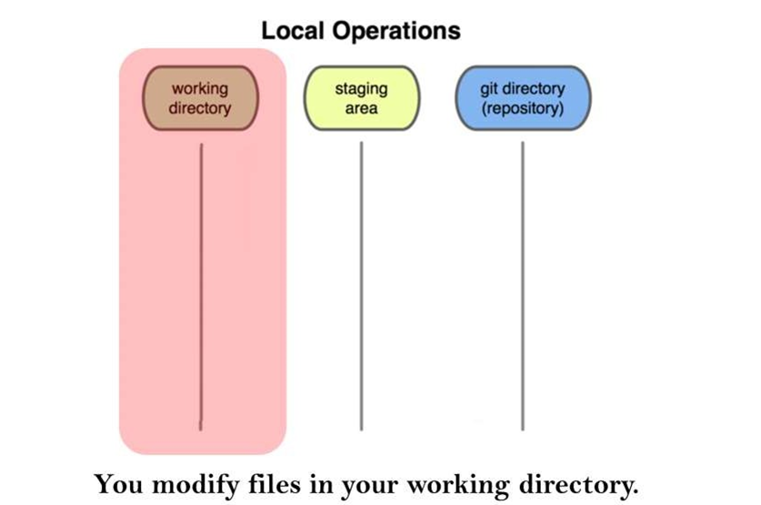
GIT WORKFLOW: THE THREE STATES

Slide 10
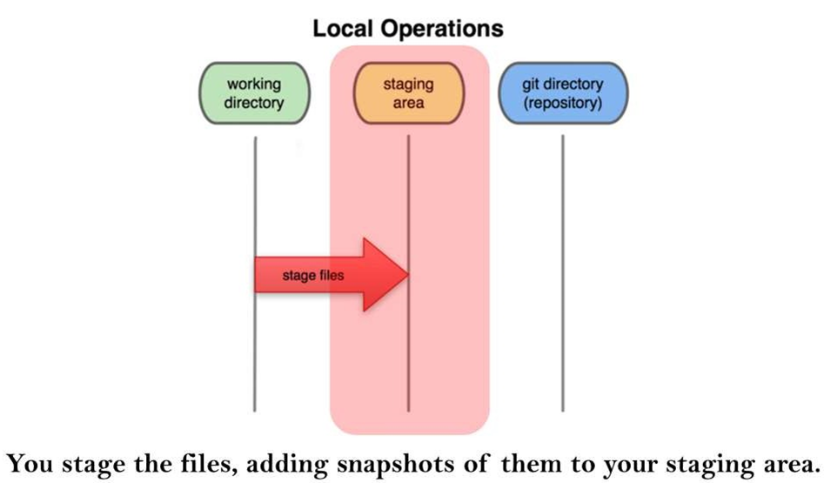
GIT WORKFLOW: THE THREE STATES

Slide 11
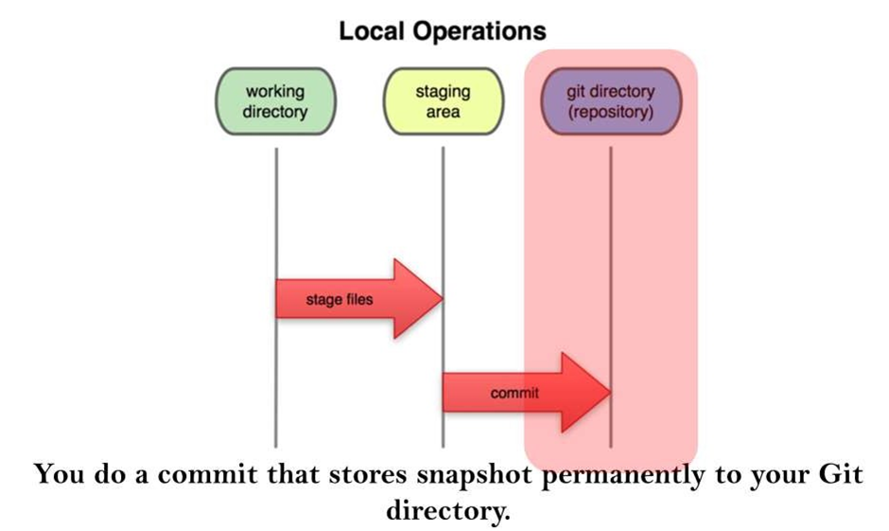
GIT WORKFLOW: THE THREE STATES

Slide 12
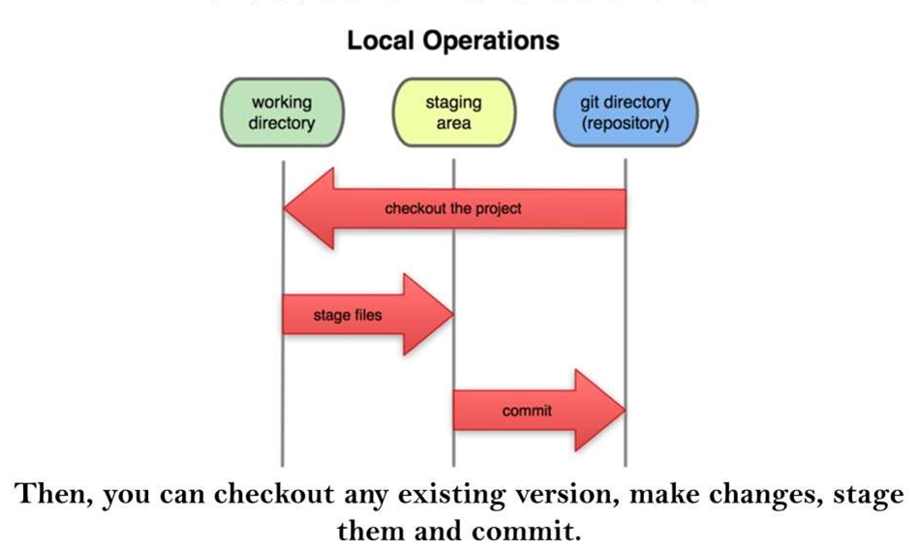
GIT WORKFLOW: THE THREE STATES

Slide 13
GIT WORKFLOW: THE THREE STATES

Slide 14
LAB WORK

Slide 15
CREATE A NEW REPOSITORY
Create a new directory, open it and run the
git init
This would create a new local git repository

Slide 16
CHECKOUT A REPOSITORY
In a new folder create a working copy of local repository
git clone /path/to/repository

Slide 17
GET GIT COMMIT HISTORY
You can study repository history using
git log
you can see last 'p' (a number) commits
git log -n p

Slide 18
GET GIT COMMIT HISTORY
You can also see git history with affected files
git log --stat
to see a compressed log where each commit is one line
git log --pretty=oneline

Slide 19
COMPARE CHANGES OVER TIME
See changes in a commit
git show commitID
and compare two commits by
git diff commitID commit2ID

Slide 20
REVERT FILES TO PREVIOUS STATES
Revert to previous state
git checkout commitID
and return to current state
git checkout master

Slide 21
ADD & COMMIT
Add new files to staging area
git add <filename>
git add *
then commit changes
git commit -m "Commit Message"

Slide 22
PUSHING CHANGES
To send this changes to your remote
repository execute
git push origin master
you can also push to a branch other than 'master'
git push origin branch_name

Slide 23
BUT WAIT...
WHAT IS ORIGIN ?
WHAT IS MASTER ?
WHAT IS BRANCH ?

Slide 24
ORIGIN
When you clone a repository for the first time
Origin is a default name given to the original remote repository that you clone, from where you want to pull and push changes
git clone /path/to/repository
By saying git push origin branch name you are saying
to push to the origin repository.

Slide 25
ORIGIN
When you initialize a new repository By convention you name you new Github remote)
repository as Origin.
git init
git remote add origin /path/to/repository
There is no requirement to name the remote repository origin, and there can be multiple remote repositories

Slide 26
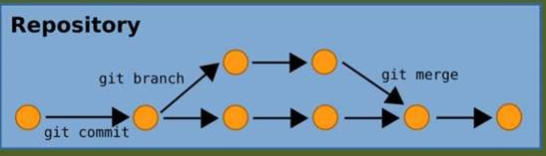
BRANCHING
Branching are used to develop features isolated from each other.
The master branch is the "default" branch when you create a repository.
Use other branches for development and merge them back to master branch upon completion.

Slide 27
BRANCHING
Branching are used to develop features isolated from each other.
The master branch is the "default" branch when you create a repository.
Use other branches for development and merge them back to master branch upon completion.

Slide 28
BRANCHING
To Create a new branch
git branch new_branch_name
switch to a different branch
git checkout other_branch_name

Slide 29
BRANCHING
To create a new branch and switch to that branch
git checkout -b new_branch_name

Slide 30
BRANCHING
To show all the branches
git branch
to delete a branch
git branch -d branch_name

Slide 31
BRANCHING
Remember , a branch is not available to others unless you push to your remote repository
git push origin branch_name

Slide 32
MERGING BRANCHES
Checkout the branch you want to update
git checkout branch_name
Then merge branches by excuting
git merge this_branch_name that_branch_name

Slide 33
MERGING BRANCHES
Git tries auto-merge changes. Unfortunately ,
this is notalways possible and results in conflicts.
You are responsible to merge those conflicts
manually by editing the files shown by git.
Useful Tip: Before merging changes , preview
changes
git diff this_branch_name that_branch_name

Slide 34
EXCERCISE
1) Form a team of 2
2) 1 member should create a repo on Github
3) The same Member will add other member as
a collaborator to the repo
4) The other member will Fork the created repo
5) Add file info.txt modify and push to the origin

